Slide 1


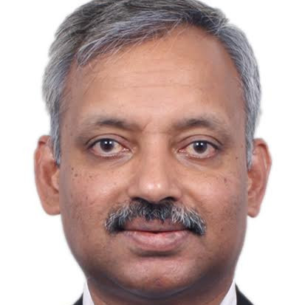




Speaker
Arun PV
Arun PV
Arun PV,PCC
September 16th & 17th
^{Online Event}
Powered By
International Conference

